Slide 1
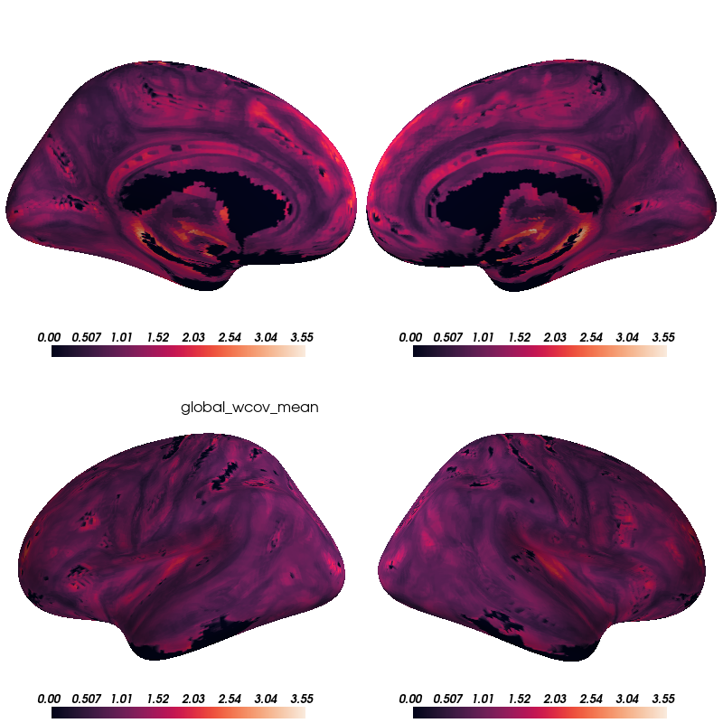

Slide 2
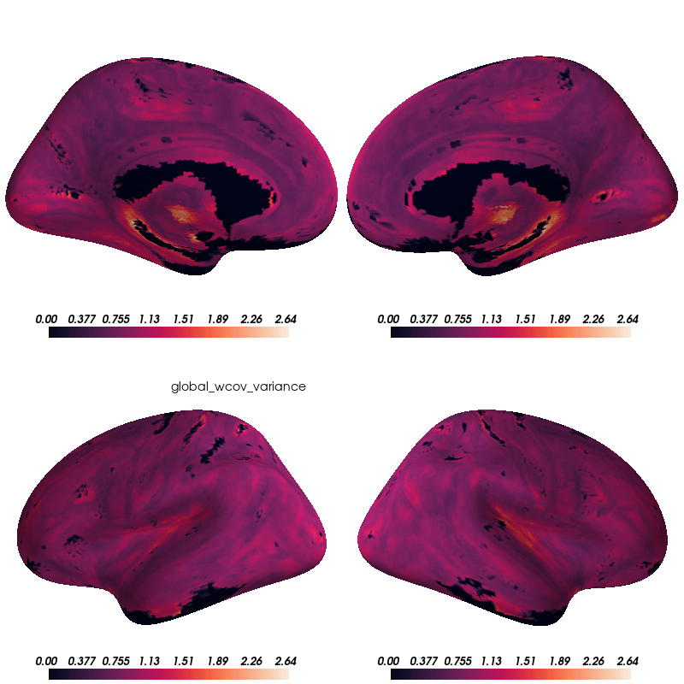

Slide 3
A
B
Figure 1. A) Voxel-wise means across subjects of cortical coupling coefficients between CBF, ALFF, and ReHo. Larger values indicate stronger coupling. B) Voxel-wise variances across subjects of cortical coupling coefficients between CBF, ALFF, and ReHo.

Slide 4
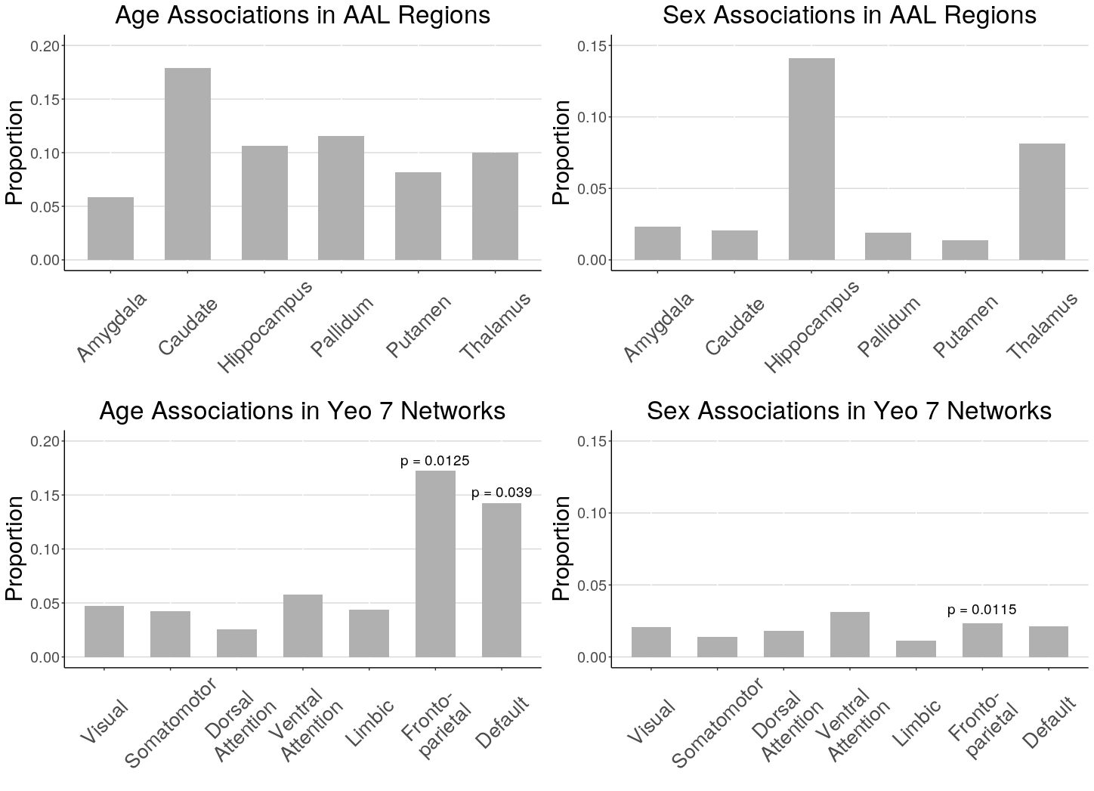
Figure 2. Proportion of voxels in AAL subcortical regions and Yeo 7 cortical networks that showed significant age and sex effects when race and in-scanner motion were corrected included as covariates (FDR corrected p < 0.05). Spin test was performed for Yeo 7 networks and significant p-values are reported (p < 0.05).

